Slide 1

Task-oriented Grasp analysis: FOR THE TRACEBOT Manipulator
Internship: Technical specifications for in-hand and dexterous manipulation at the lab LASR of CEA Nano-Innov
Ricardo RICO URIBE

Slide 2
Objective
Determine the best hand configuration to perform the tasks shown on the video
The objective evolved to be:
Determine the force required on the surface of the objects according with their tasks and specific ways of holding them with the use of grasp theory
To accomplish the objective we implemented on python:
A class capable of reading the 3d files (.stl) that represent the objects and creating on the surface of them the different contact points that represent a real life grasp
A class that calculates the grasp matrix of the contact point arrangement
Two metrics that produce the force-on-the-surface information regarding the external perturbations of the object (tasks)

Slide 3




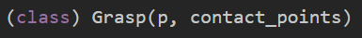


FLOW & Elements
From a .stl file we can create a STL object, we can use a method to declare the contact points in the surface according to their coordinates. With several contact points we can create a Grasp object and use the quality metrics to obtain the force required for such grasp configuration.

Slide 4
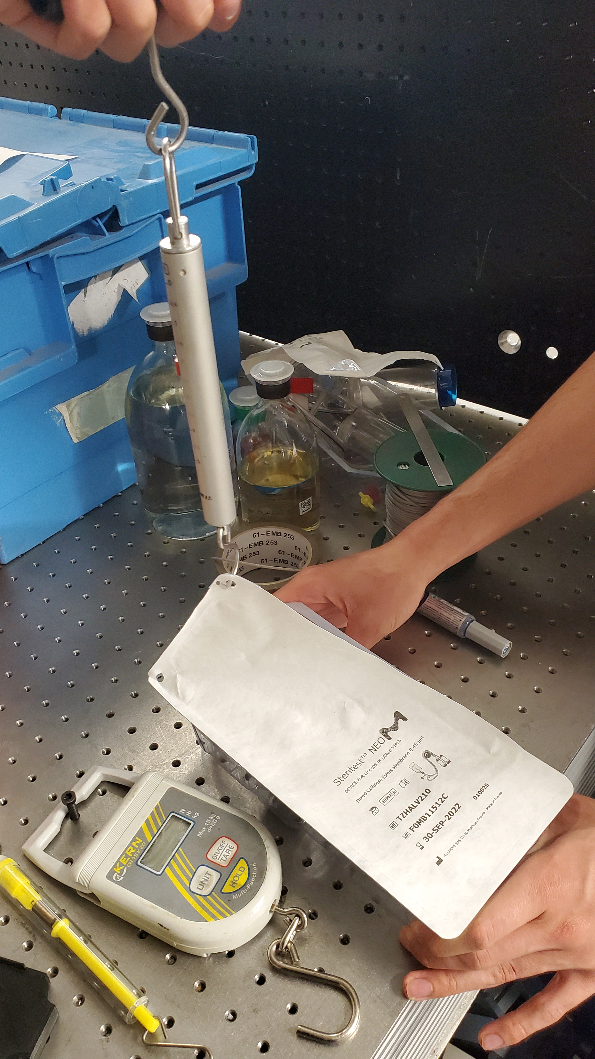
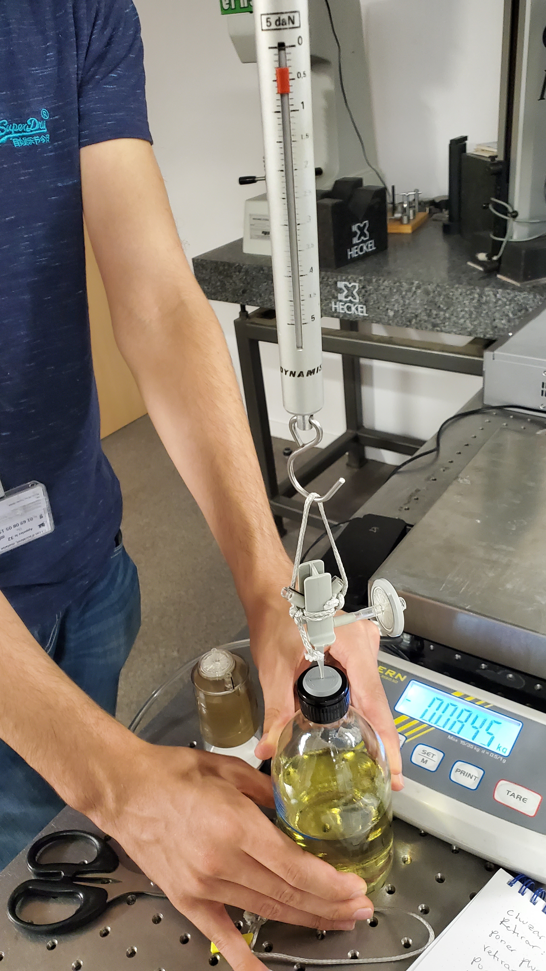
PERTURBATION Measurement
Force required to open the kit, can be interpreted as the perturbation felt by the kit as we pull the tab.
Force required to pull out the needle, can be interpreted as the perturbation felt by the needle as the bottle sticks to the needle.

Slide 5
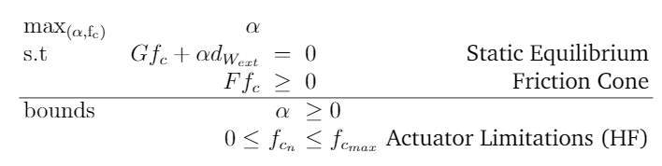
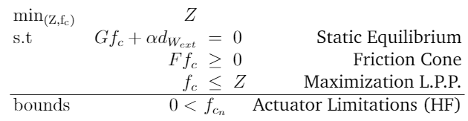
Quality Metrics
By maximizing alpha we obtain the maximum force the grasp can resist in a specific direction.
By minimizing the upper bound of the forces we create a minimax problem for Fc, where we search to minimize the maximal force of the grasp.
This gives us the forces of the grasp for a specific perturbation

Slide 6
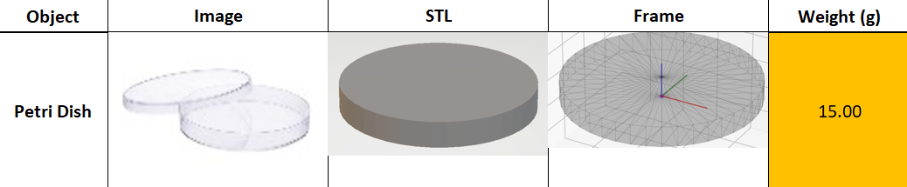
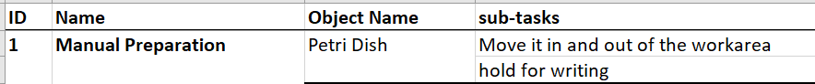
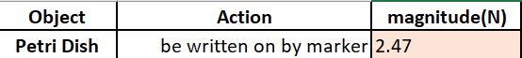
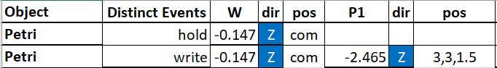
Object description
With the information regarding each object, and the perturbations that affect it, we can use the code to calculate the forces required for the grasps

Slide 7
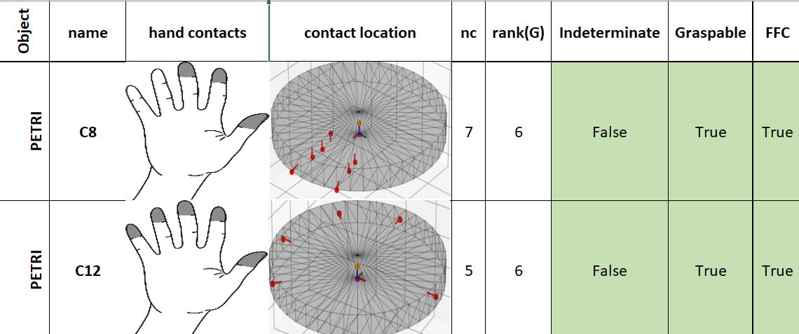
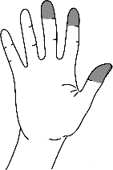
Grasping Results
For each object we have a list of possible ways of grasping it, with those configurations we can determine their mathematical characteristics.

Slide 8
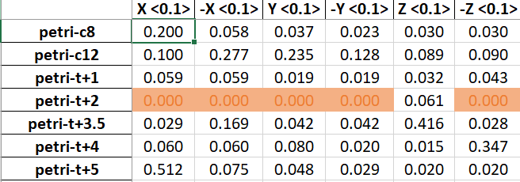
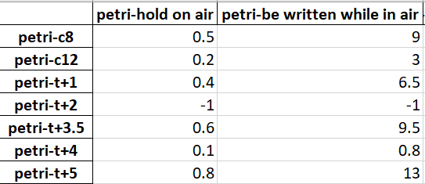
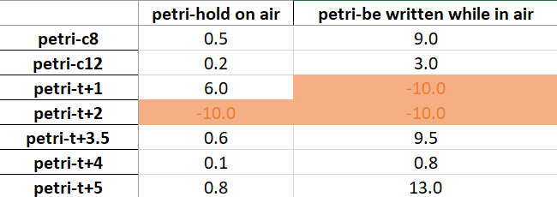

Force RESULTS
With a full description of the perturbation we can determine the force required for each grasp with each metric
α
Alpha gives us the maximal force in a specific direction with a maximal allowed force
We these results we can determine the torque for the motors so that the force at the contact points is at least the value found, for instance:
For the grasp c-12 to resist the task of being written we need to apply at the contact points at least 9 N
$$f_{c}$$

